Slide 1
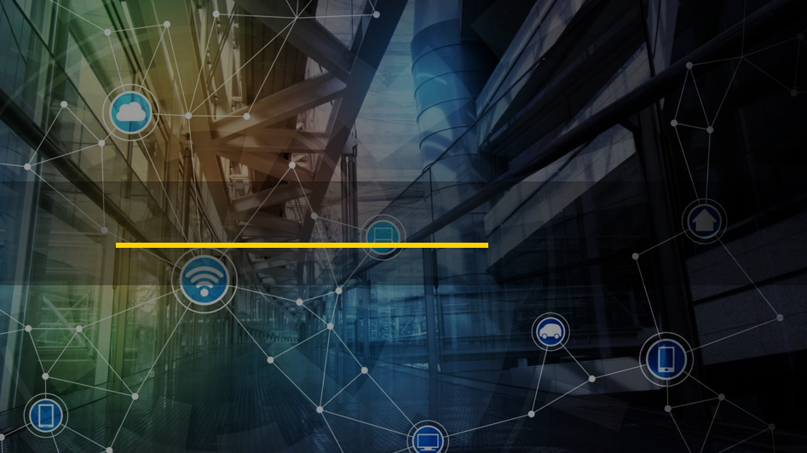

Data Protection and Privacy
Shaikh Muhammad Siddique
SCSP Community

Slide 2
Agenda
Definition
Common Data Loss Channels
Linking the topics
Data Protection Lifecyle
Question to ask ?
Data Protection Program Model
Information Carriers
Challenges and Benefits

Slide 3
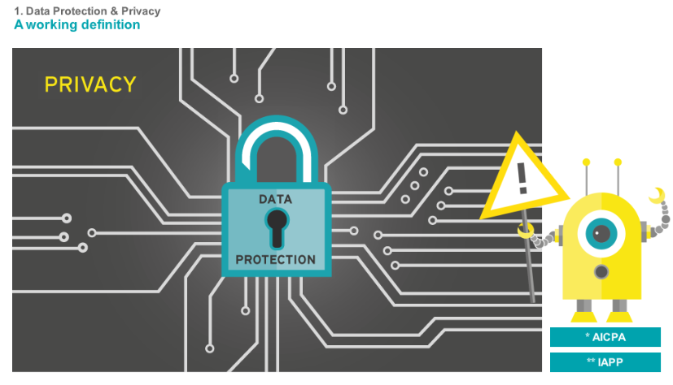
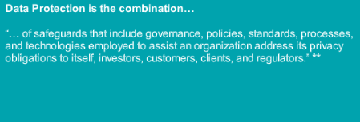
Data Protection and Privacy - Definition
:

Slide 4
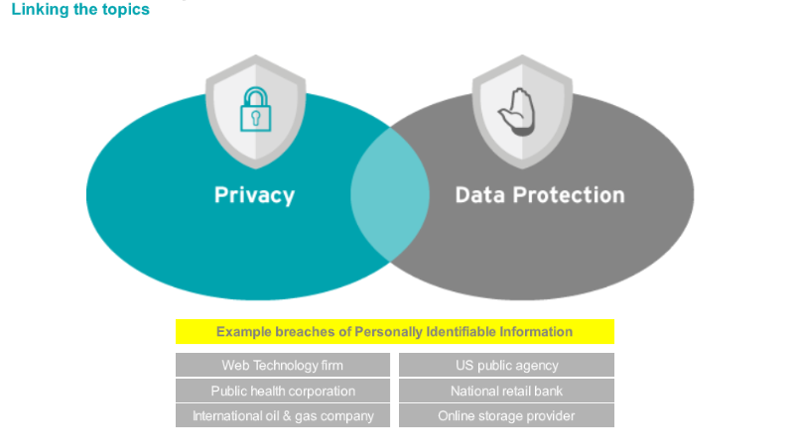
Data Protection and Privacy
Privacy and data protection are business risks that are multifaceted….
Protection is a personal, social, legal and business issue
“Data protection” refers to full suite of processes and controls in place to protect an organization’s data, both from internal and external threats
Data Loss Prevention or DLP : One component of an effective “Data Protection” program
Protective measure to prevent prejudices and establishes processes and technology to help accomplish privacy and data protection goals

Slide 5
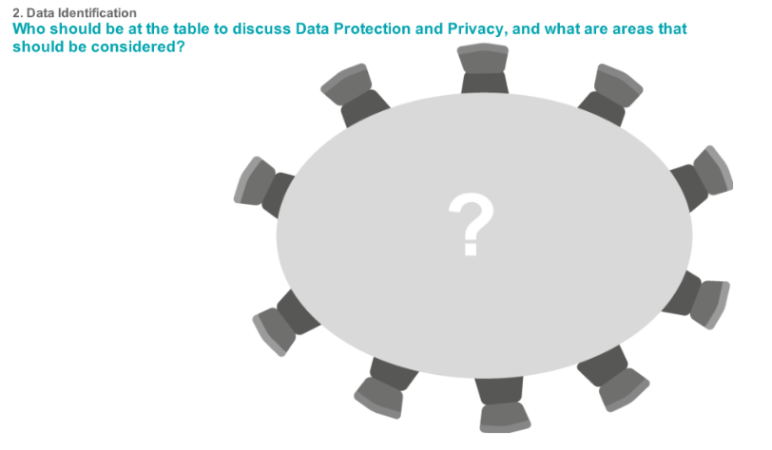
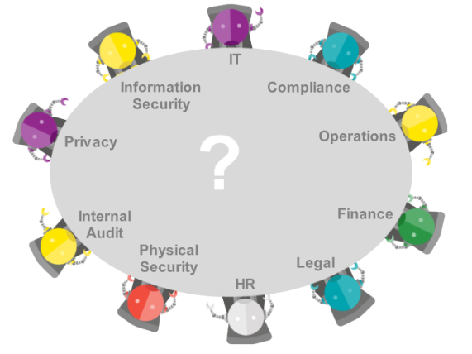
Data Identification
Questions
Does the organization know what types of data they have that others would want?
Do key stakeholders understand business risks and regulatory requirements?
What has been done to validate, that the data protection program is properly aligned with business?
Does the organization have a plan to react when a data breach occurs to minimize the harm?
The entire organization needs to work together to protect all the valuable data

Slide 6
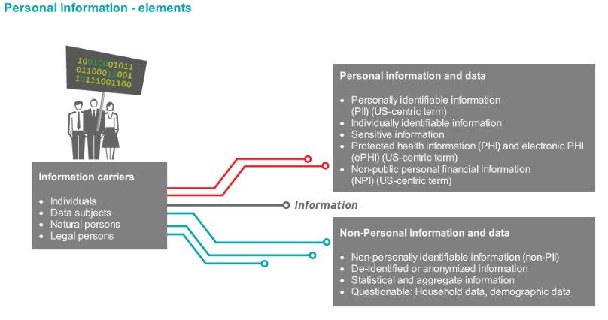
Data Identification
Organizations have two types of information and data
Different types of information carriers

Slide 7
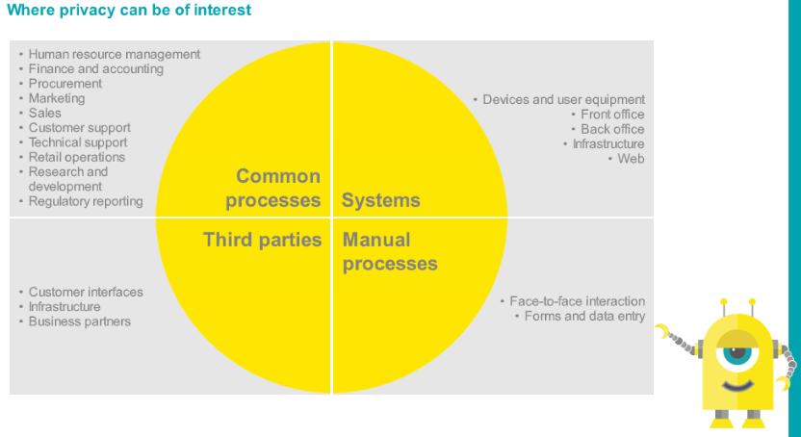
Data Identification
Privacy can be of any interest anywhere in the Organization where personal or confidential information is processed
Personal or Confidential information
Systems and mishandling faults
Working with suppliers
Daily work processes

Slide 8
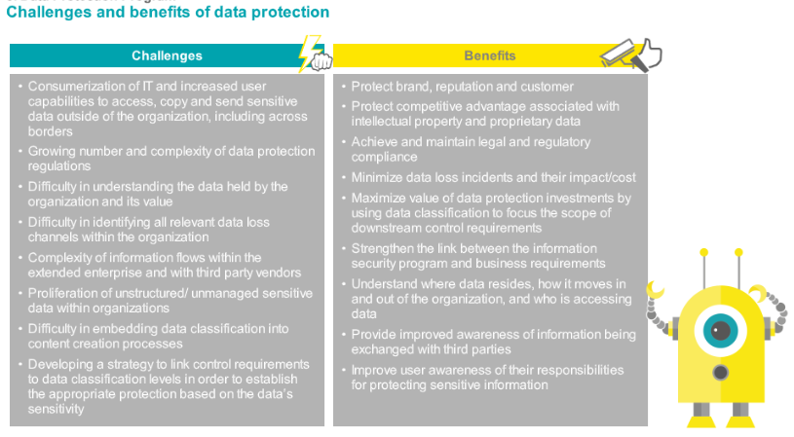
Data Protection and Privacy Program

Slide 9
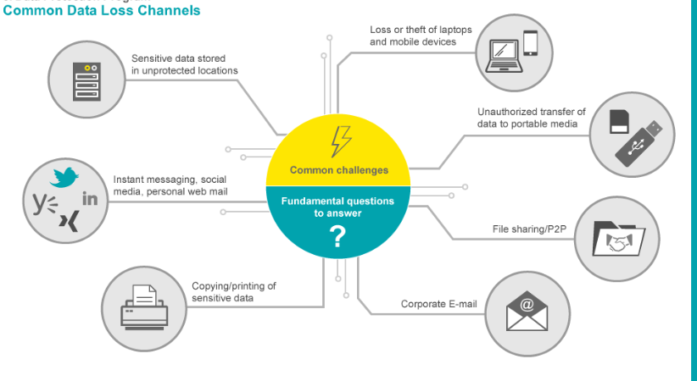

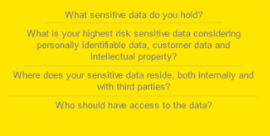
Data Protection and Privacy Program
Common Challenges
Fundamental question to answer

Slide 10
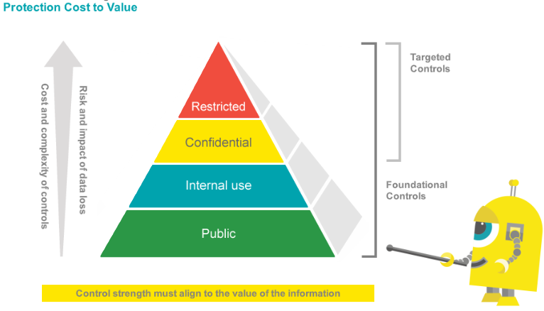
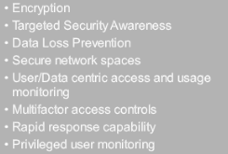
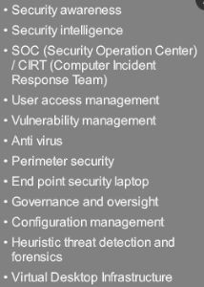
Data Protection and Privacy Program

Slide 11
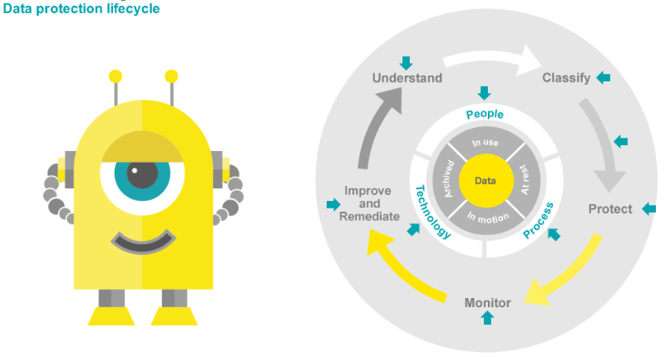
Data Protection and Privacy Program

Slide 12
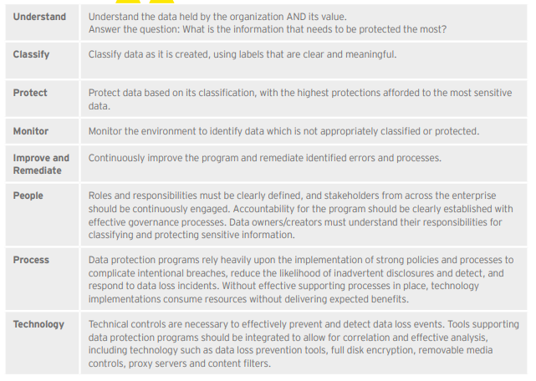
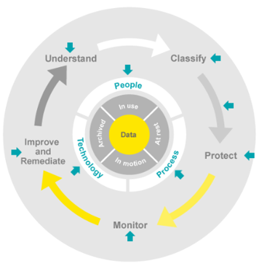
Data Protection and Privacy Program

Slide 13
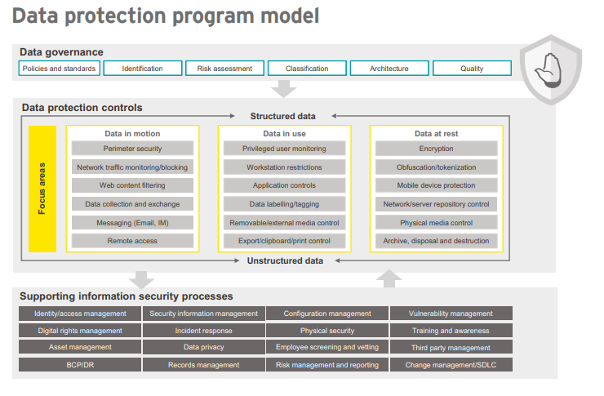
Data Protection and Privacy Program
Holistic View
Holistic view of data protection with a focus on aligning controls to the data that matters most to the business
Data Governance aligns the data protection program to the business and drives control requirements
Sets overall tone for how a company will handle Cybersecurity
Company will not have adequate controls identified to handle cyber threats – Without strong Governance
Handle all the types of data - via a strong governance
Controls linked with numerous IS processes must be effective to support CIA of data within organization

Slide 14
Data Protection and Privacy Program
Data in motion
Focus areas | Example control objectives | Supporting technologies
Perimeter security | Deter and detect unauthorized external users from compromising internal systems. Block inappropriate ingress & egress channels | Firewalls, proxy servers, IDS/IPS, Advanced malware detection, packet capture tools, etc.
Network traffic monitoring/ blocking | Log and monitor network traffic to identify, investigate and potentially block inappropriate sensitive data transfers based on content analysis. | DLP technology (Network Monitor/Prevent)
Web content filtering | Prevent users from accessing unauthorized and malicious sites or uploading data through the web through personal webmail, social media, file sharing tools (i.e. Dropbox), online backup tools, etc. | Proxy servers, content filters, firewalls
Data collection and exchange with third parties | Data exchange with third parties only occurs through secure communications protocols. | DLP technology, secure email, secure FTP, secure APIs, encrypted physical media, secure portals
Messaging | Detect and prevent sensitive file transfers to external parties through email, instant messaging and other applications. | DLP technology, firewalls, proxy servers, workstation restrictions, group policy, application whitelisting
Remote access | Remote access to the organization’s systems is secured using strong authentication techniques. Controls restrict the data that can be saved through remote facilities such as Outlook Web Access. | VPN technology, restrictions on use of remote access tools to prevent data leakage to non-corporate assets

Slide 15
Data Protection and Privacy Program
Data in use
Focus areas | Example control objectives | Supporting technologies
Privileged user monitoring | Monitor the actions of privileged users with the ability to override DLP controls, perform mass data extracts, etc. | Security information and event monitoring, operating database and application log files
Workstation restrictions | Restrict access to local admin functions such as the ability to install software and modify security settings. Prevent malware, viruses, spyware, etc. | Operating system workstation restrictions, security software (A/V, personal firewall, etc.), endpoint DLP technology, application whitelisting
Application controls | Prevent unnecessary data extracts and copying and pasting from applications. Limit user access to sensitive data elements to only data they must view in order to perform job responsibilities. | Application functionality, Endpoint DLP technology, Digital Rights Management (DRM) systems
Data labelling/ tagging | Label sensitive unstructured data in accordance with data classification policies. Apply tags that move with files and can be used to trigger downstream controls such as data loss prevention. | Data labeling tools, DRM systems
Removable/ external media control | Prevent the copying of sensitive data to unapproved media. Ensure authorized data extraction only takes place on encrypted media. | Endpoint DLP technology, endpoint media encryption tools, operating system workstation restrictions, DRM
Export/ clipboard/ print control | Restrict user abilities to copy sensitive data into unapproved applications, such as e-mail, web browsers, etc., including controlling the ability to copy, paste and print sections of documents. | Endpoint DLP technology, application controls, DRM systems

Slide 16
Data Protection and Privacy Program
Data at rest
Focus areas | Example control objectives | Supporting technologies
Encryption | Encrypt sensitive data at rest, whether it is stored in databases or unstructured repositories. Employ full disk encryption on workstations, laptops & servers. | Security information and event monitoring, operating database and application log files
Obfuscation/ tokenization | Use obfuscation/tokenization techniques for storing and presenting sensitive data elements where the actual values are not required. | Operating system workstation restrictions, security software (A/V, personal firewall, etc.), endpoint DLP technology, application whitelisting
Mobile device protection | Harden mobile device configurations and enable features such as password protection, remote wipe facilities, etc. Enable mobile device encryption. Store corporate data in a separate, encrypted container from the mobile device platform. | Application functionality, Endpoint DLP technology, Digital Rights Management (DRM) systems
Network/server repository control | Govern access to network-based repositories containing sensitive data on a least privilege basis. Scan public drives for sensitive content. Periodically review access and content stored in repositories for appropriateness. Inventory and carefully manage access to sensitive repositories. | Data labeling tools, DRM systems
Physical media control | Secure sensitive physical media, including hard copy records. Encrypt sensitive data at rest on physical media such as backup tapes. | Endpoint DLP technology, endpoint media encryption tools, operating system workstation restrictions, DRM
Archive, disposal and destruction | Ensure all equipment with data storage capabilities are cleansed or destroyed as part of the equipment disposal process. (Including devices such as digital copiers, fax machines, etc.) Shred bins are used to dispose of hard copy records. | Endpoint DLP technology, application controls, DRM systems

Slide 17




Thank you for watching
Get in touch with us:
scsp.community@gmail.com
facebook.com/scspcommunity/
SCSP Community Channel
github.com/scsp-community

